Slide 1
The Waterfall Model

Slide 2
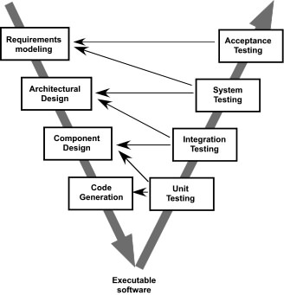
The V-Model

Slide 3
The Incremental Model

Slide 4
Evolutionary Models: Prototyping
Quick
plan
communication
Modeling
Quick design
Deployment
delivery &
feedback
Construction
of prototype
Construction
of prototype

Slide 5
Evolutionary Models: The Spiral

Slide 6
Evolutionary Models: Concurrent

Slide 7
Still Other Process Models
Component based development—the process to apply when reuse is a development objective
Formal methods—emphasizes the mathematical specification of requirements
AOSD—provides a process and methodological approach for defining, specifying, designing, and constructing aspects
Unified Process—a “use-case driven, architecture-centric, iterative and incremental” software process closely aligned with the Unified Modeling Language (UML)

Slide 8
The Unified Process (UP)
elaboration
inception

Slide 9
UP Phases

Slide 10
UP Work Products

Slide 11
Personal Software Process (PSP)
Planning. This activity isolates requirements and develops both size and resource estimates. In addition, a defect estimate (the number of defects projected for the work) is made. All metrics are recorded on worksheets or templates. Finally, development tasks are identified and a project schedule is created.
High-level design. External specifications for each component to be constructed are developed and a component design is created. Prototypes are built when uncertainty exists. All issues are recorded and tracked.
High-level design review. Formal verification methods (Chapter 21) are applied to uncover errors in the design. Metrics are maintained for all important tasks and work results.
Development. The component level design is refined and reviewed. Code is generated, reviewed, compiled, and tested. Metrics are maintained for all important tasks and work results.
Postmortem. Using the measures and metrics collected (this is a substantial amount of data that should be analyzed statistically), the effectiveness of the process is determined. Measures and metrics should provide guidance for modifying the process to improve its effectiveness.

Slide 12
Team Software Process (TSP)
Build self-directed teams that plan and track their work, establish goals, and own their processes and plans. These can be pure software teams or integrated product teams (IPT) of three to about 20 engineers.
Show managers how to coach and motivate their teams and how to help them sustain peak performance.
Accelerate software process improvement by making CMM Level 5 behavior normal and expected.
The Capability Maturity Model (CMM), a measure of the effectiveness of a software process, is discussed in Chapter 30.
Provide improvement guidance to high-maturity organizations.
Facilitate university teaching of industrial-grade team skills.

